Slide 1
Lecture 16 CUDA Thrust Template Library
Kyu Ho Park
May 30, 2017
Ref:
1.THRUST Quick Start Guide, DU-06716-001_v8.0, Jan.2017,NVIDIA.
2.Gerassimos Barlas,Multicore and GPU Programming, MK.
3.David Kirk and Wen-mei Hwu, Programming Massively Parallel Processors, MK and NVIDIA.
4.Duane Storti,Mete Yurtoglu,CUDA for Engineers,Addison Wesley.

Slide 2
Thrust
Thrust: A productivity oriented library for CUDA.
Thrust is a C++ template library for CUDA based on the Standard Template Library(STL) .
It brings a high-level interface to the GPU computing maintaining the full interoperability with the rest of the CUDA software environment.
Thrust reduces the effort of developing parallel applications significantly.

Slide 3
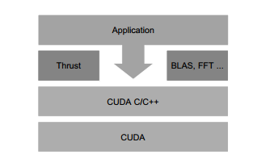
Thrust
[NVIDIA]

Slide 4
Function Template
float add(float a,float b){
float sum=0;
sum=a+b;
return sum;
}
Program 1
int add(int a,int b){
int sum=0;
sum=a+b;
return sum;
}
Program 2

Slide 5
Generic function
template <typename T>
T add(T a,T b) {
T sum=0;
sum=a+b;
return sum;
}
-The ‘template’ keyword indicates the beginning of a type-generic definition.
-The key concept of generic programming is the use of
type parameters such as T that can be replaced by arbitrary types.
-Thrust is a library of generic functions.

Slide 6
addTemplate.cpp
#include <iostream>
using namespace std;
template <typename T>
T add(T a, T b){ return a+b;
}
int main(void){
cout<<add<int>(1,2) <<endl;
cout<<add<float>(1.5,2.1)<<endl;
cout<<add<double>(1.512, 2.072)<<endl;
return 0;
}

Slide 7
Class Template
class Point {
public:
Point(int x=0,int y=0):xpos(x),ypos(y)
{…….}
void PrintPosition( ) const
{ cout<<xpos <<“,”<<ypos<<endl;}
};
template <typename T>
class Point
{
public:
Point(T x=0, T y=0):xpos(x),ypos(y) {…..}
…
Point<int>
Point<double>
Point<char>
..,

Slide 8
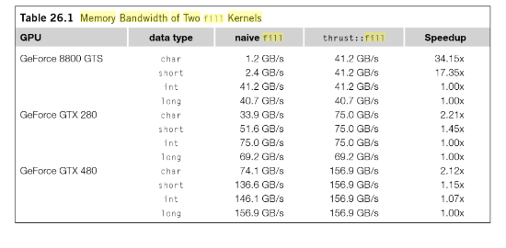
Why thrust?
High Productivity.
Hiding Complexity.
Quick prototyping applications.
Generic programming.
[Wen-Mei Hwu,GPU Computing Gems,Chapter26, pp365,Jade Edition]

Slide 9
C++ STL
At the core of the C++ Standard Template Library are following three well-structured components:
Component | Description
Containers | Containers are used to manage collections of objects of a certain kind. There are several different types of containers like deque, list, vector, map etc.
Algorithms | Algorithms act on containers. They provide the means by which you will perform initialization, sorting, searching, and transforming of the contents of containers.
Iterators | Iterators are used to step through the elements of collections of objects. These collections may be containers or subsets of containers.
[http://www.tutorialspoint.com/cplusplus/cpp_stl_tutorial.htm]

Slide 10
Thrust
Component | Description(C++ STL)
Containers | Containers are used to manage collections of objects of a certain kind. There are several different types of containers like dequeue, list, vector, map etc.
Algorithms | Algorithms act on containers. They provide the means by which you will perform initialization, sorting, searching, and transforming of the contents of containers.
Iterators | Iterators are used to step through the elements of collections of objects. These collections may be containers or subsets of containers.
Component | Thrust
Containers | thrust::host_vector<T>,thrust::device_vector<T>
Algorithms | thrust::transform(),thrust::reduce(),
Iterators | thrust::constant_iterator,thrust::counting_iterator(),thrust::transform_iterator(),thrust::permutation_iterator()

Slide 11
Containers
Thrust two vector containers:
host_vector,
device_vector
It hides cudaMalloc and cudaMemcpy.

Slide 12
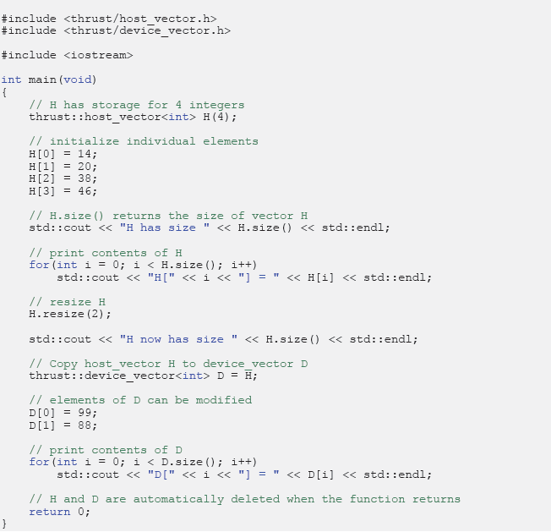
ref:[1]

Slide 13

thrust algorithms
Data management
Transformations
Sorting and searching
Reductions
Scans/prefix-sums
Data management

Slide 14
thrust::fill
void thrust::fill( ForwardIterator first,
ForwardIterator last,
const T & value )
,where
first :The beginning of the sequence,
last :The end of the sequence,
value :The value to be copied.
Example:
#include <thrust/fill.h>
#include <thrust/device_vector.h>
…..
thrust::device_vector<int> a(4);
thrust::fill(a.begin(),a.end(), 0);

Slide 15
thrust::sequence()
void thrust::sequence( ForwardIterator first,
ForwardIterator last,
T init,
T step )
,where
first :The beginning of the sequence,
last :The end of sequence,
init :The first value of the sequence of numbers,
step :The difference between consecutive elements.
Example:
#include <thrust/sequence.h>
….
const int a[10];
thrust::sequence(a,a+10,1,2); 1 3 5 7 9 11 ...19

Slide 16
thrust::copy
OutputIterator thrust::copy( InputIterator first,
InputIterator last,
OutputIterator result)
,where
first :The beginning of the sequence to copy,
last :The end of the sequence to copy,
result :The destination copy.
Example:
thrust::device_vector<int> a(10);
thrust::device_vector<int> b(10);
thrust::copy(a.begin(),a.end(),b.begin());

Slide 17
thrust::replace
void thrust::replace( ForwardIterator first,
ForwardIterator last,
const T & old_value,
const T & new_value )
Example:
thrust::device_vector<int> c(4)
c[0]=100;c[1]=98;c[2]=97;c[3]=100;
thrust::replace(c.begin(),c.end(),100,1);
c[0]=1 , c[1]=98 , c[2] =97 , c[3] =1

Slide 18
Thrust Data Types
Thrust vector classes provide the same functionality as the STL vector template class.
int N=100;
thrust::device_vector<int> d_x(N);
//100 elements of a device vector d_x are allocated.
d_x.resize(1000);
cout<<“Modified size of d_x:”<<d_x.size() <<endl;
thrust::host_vector<int>h_x(100, 0); //h_x are all set to 0
thrust::host_vector<float>h_x(N);
thrust::copy(d_x.begin()+5,d_x.begin()+10,h_x.begin());

Slide 19
Thrust Data Type
//insert
thrust::host_vector<int>h_x(10,0);
thrust::host_vector<int>h_y(10);
h_data.insert(h_x.begin(),h_y.begin(),h_y.end());
//erase
h_data.erase(h_x.begin()+12,h_x.end());

Slide 20
fill and sequence
//fill and sequence
#include <thrust/fill.h>
#include <thrust/sequence.h>
thrust::fill(d_x.begin(),d_x.begin+10,100);
//fills the first 10 elements of d_x with 100.
thrust::sequence(d_x.begin()+10,d_x.begin()+20);
//fills the next 10 elements of d_x with the sequence 0,1,2,3,…
//The initial and step values can also be specified.
//thrust::sequence(d_x.begin(),d_x.end(),0,3),0:initial value, 3:step

Slide 21
Iterators
Iterators operate just like pointers to array elements.
thrust::device_vector<int> d_a(5);
d_a.begin();
d_a.end();
a[0] | a[1] | a[2] | a[3] | a[4]
d_a.begin()
d_a.end()

Slide 22
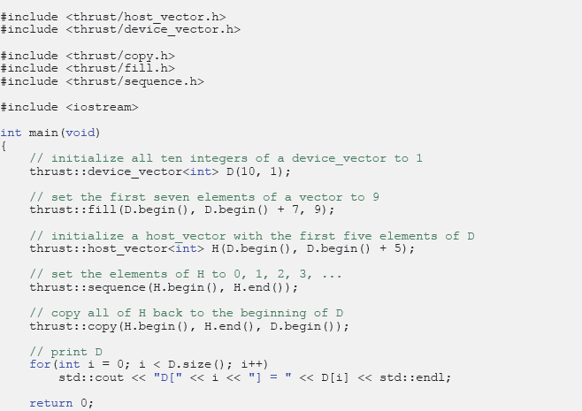
thrust::fill, copy, and sequence for the initialization of a vector
ref:[1]

Slide 23
thrust algorithms
Transformations
Sorting and searching
Reductions
Scans/prefix-sums
Data management

Slide 24
thrust::transform()
OutputIterator thrust::transform(InputIterator first, InputIterator last,
OutputIterator result, Unaryfunction op)
,where
first :the beginning of the input sequence,
last :the end of the input sequence,
result :the beginning of the output sequence,
op :the transformation operation.
It returns the end of the output sequence.

Slide 25
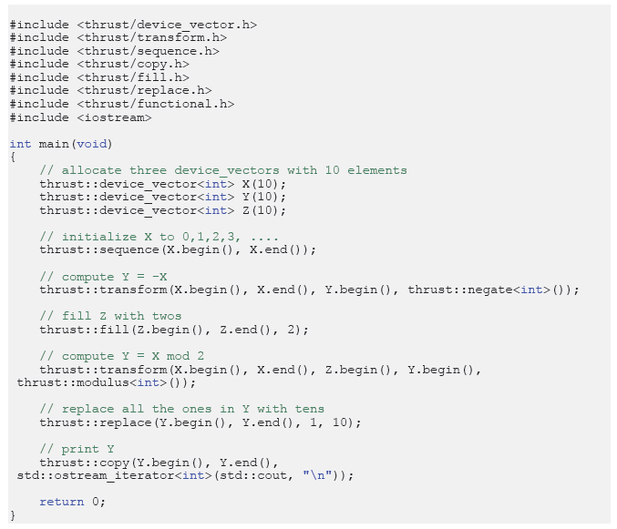
transform
ref:[1]

Slide 26
SAXPY
-SAXPY stands for “Single-Precision AX Plus Y”.
-z=ax + y, where x,y,z are vectors and a is a scalar.

Slide 27
CUDA C SAXPY
__global__ void saxpy(int n, float a, float *x, float *y) { int i=blockIdx.x*blockDim.x + threadIdx.x;
if( i<n) y[i]=a*x[i] + y[i];
…..
int N=1<<20;
cudaMemcpy(d_x, x, N, cudaMemcpyHostToDevice);
cudaMemcpy(d_y, y, N, cudaMemcpyHostToDevice);
saxpy<<<4096,256>>>(N,2.0,x,y);
cudaMemcpy(y,d_y,N,cudaMemcpyDeviceToHost;
….

Slide 28
Thrust SAXPY
void saxpy(float a, thrust::device_vector<float> &x,thrust::device_vector<float>&y) {
thrust::device_vector<float> temp(x,size);
//temp← a
thrust::fill(temp.begin(), temp.end(),a);
//temp←a*x
thrust::transform(x.begin(),x.end(),temp.begin(),temp.begin(),
thrust::multiplies<float>());
//y←a*x + y
thrust::transform(temp.begin(),temp.end(),
y.begin(),y.begin(),
thrust::plus<float>());
}

Slide 29
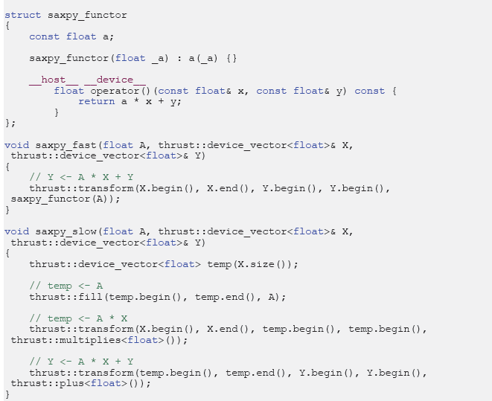
transform
Ref:[1]

Slide 30
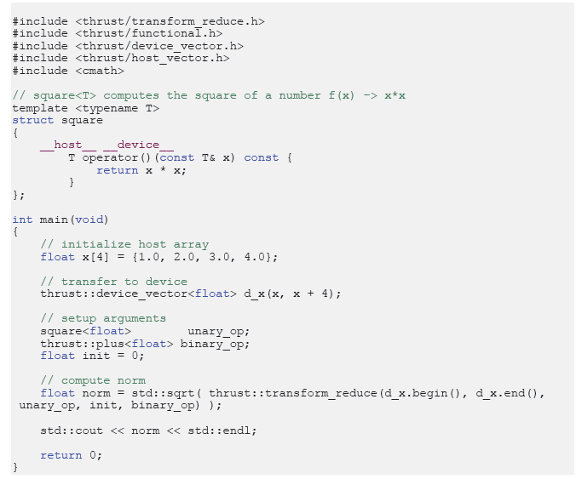
Norm of a vector
ref:[1]

Slide 31
Prefix-Sums
#include <thrust/scan.h>
int data[6]={0,1,2,3,4,5};
thrust::inclusive_scan(data,data+6,data);
Result:
data[6] is now {0,1,3,6,10,15}

Slide 32
Sorting
#include <thrust/sort.h>
….
const int N=6;
int A[N]={0,3,2,5,4,1};
thrust::sort(A,A+N);
int keys[N]={1,4,2,8,5,7};
char values[N]={‘a’,’b’,’c’,’d’,’e’,’f’,’d’}
thrust::sort_by_key(keys,keys+N,values);
//keys ={1,2,4,5,7,8} and values={‘a’,’c’,’b’,’e’,’f’,’d’}

Slide 33
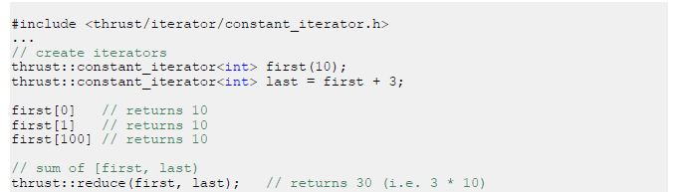
Iterator:constant_iterator
ref:[1]

Slide 34
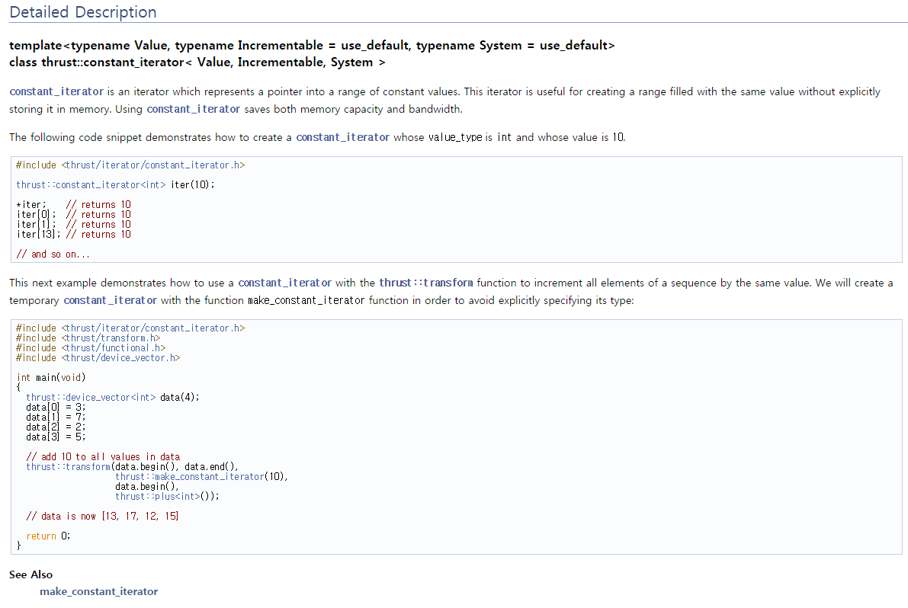

Slide 35
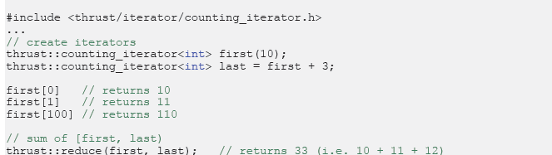
counting_iterator
ref:[1]

Slide 36
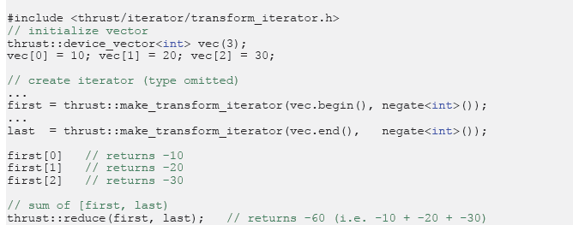
transform_iterator
ref:[1]

Slide 37
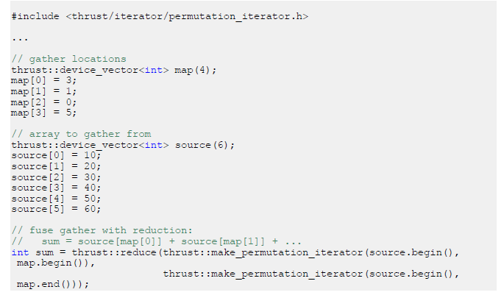
permutation_iterator
ref:[1]

Slide 38
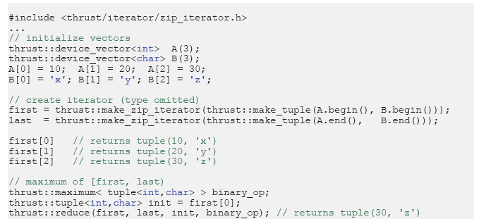
zip_iterator

Slide 39

Application:Calculating $π$
Pseudocode:
int inside=0;
for(int i=0;i<N;i++){
double x,y,distance;
x=rand();
y=rand();
distance=x*x+y*y;
if(distance <=1) inside++;
}
double PI=4.0*inside/N;

Slide 40
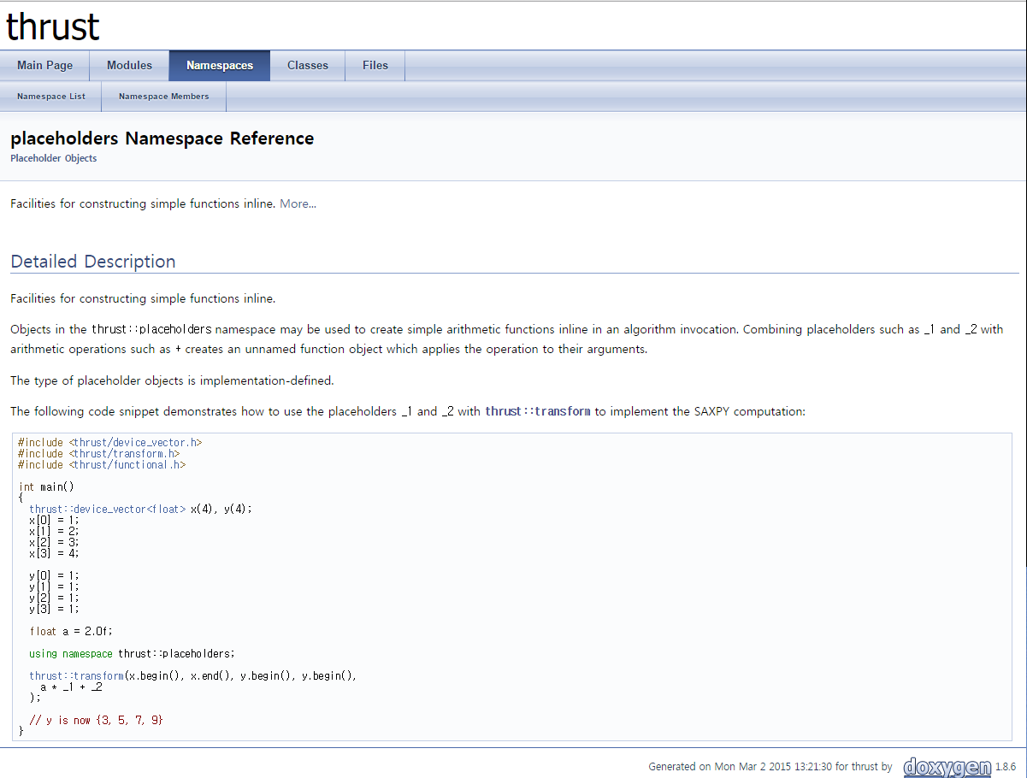

Slide 41
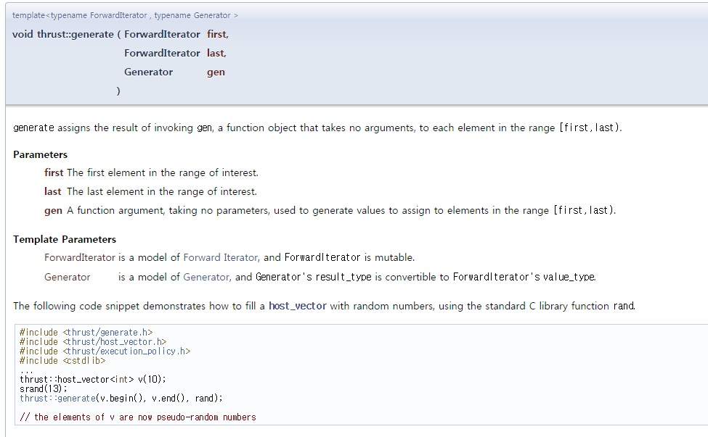

Slide 42
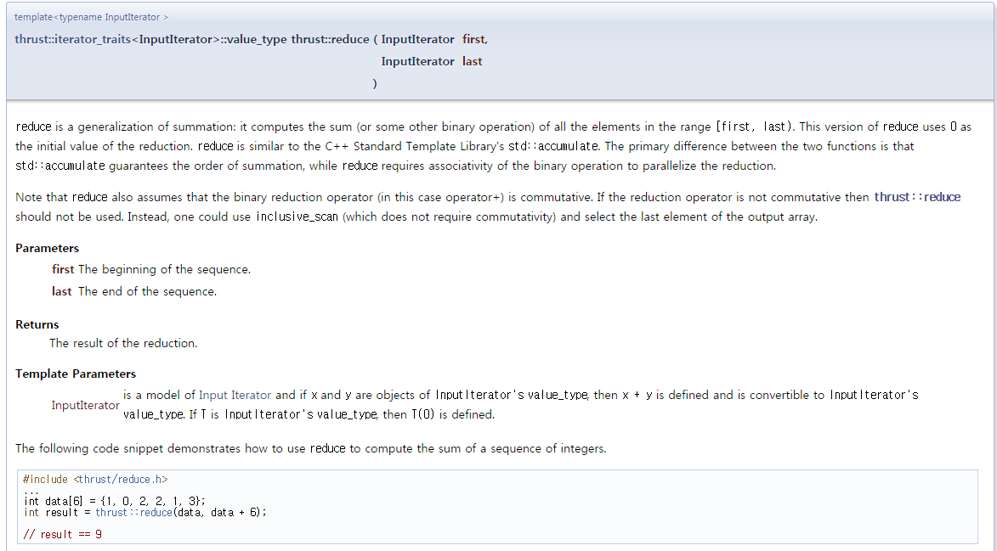

Slide 43
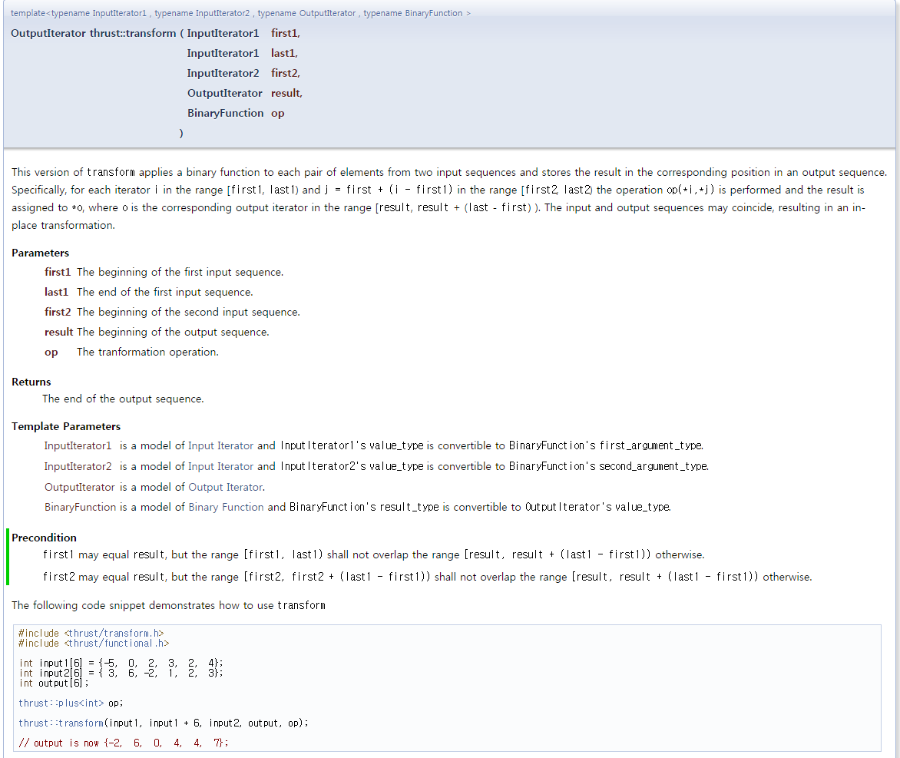

Slide 44
#include <thrust/host_vector.h>
#include <thrust/device_vector.h>
#include <thrust/reduce.h>
#include <thrust/generate.h>
#include <thrust/transform.h>
#include <math.h>
#include <stdio.h>
#define N (1<<20)
using namespace thrust::placeholders;
int main(void)
{
thrust::host_vector<float>h_x(N);
thrust::host_vector<float>h_y(N);
thrust::generate(h_x.begin(),h_x.end(),rand);
thrust::generate(h_y.begin(),h_y.end(),rand);
thrust::device_vector<float> d_x=h_x;
thrust::device_vector<float> d_y=h_y;
thrust::transform(d_x.begin(),d_x.end(),d_x.begin(), _1/RAND_MAX);
thrust::transform(d_y.begin(),d_y.end(),d_y.begin(), _1/RAND_MAX);
thrust::device_vector<float>d_inCircle(N);
thrust::transform(d_x.begin(),d_x.end(),d_y.begin(),d_inCircle.begin(),
(_1*_1 + _2*_2)<1);
float pi=thrust::reduce(d_inCircle.begin(),d_inCircle.end())*4.f/N;
printf("pi=%f\n",pi);
return 0;
}
Ref:[4]

Slide 45
